Slide 1


SAP UI5 & FIORI
Concepts
www.zarantech.com
© Copyright 2021, ZaranTech LLC. All rights reserved.

Slide 2

Disclaimer
2
This presentation, including examples, images, and references are provided for informational purposes only.
Complying with all applicable copyrights laws is the responsibility of the user.
Without limiting the rights under copyright, no part of this document may be reproduced, stored or introduced into a retrieval system, or transmitted in any form or by any means.
Credits shall be given to the images taken from the open-source and cannot be used for promotional activities.
© Copyright 2021, ZaranTech LLC. All rights reserved.

Slide 3
Agenda
3
Model View Controller (MVC)
Resource Handling
Libraries
SAPUI5 Components
Fragments
© Copyright 2021, ZaranTech LLC. All rights reserved.

Slide 4
Concepts
2
MVC Concept
Model-View-Controller (MVC) concept is used in SAP UI5 development to keep the application data separate from the user interactions.
This allows you to develop the web applications and make changes to the applications independently.
Model is responsible for managing the application data in the database/backend.
View is responsible for defining the user interface to users. When a user sends a requests from his device, the view is responsible for data view as per the request submitted.
Controller is used to control the data and view events as per user interaction by updating the view and model.
‹#›
© Copyright 2021, ZaranTech LLC. All rights reserved.

Slide 5
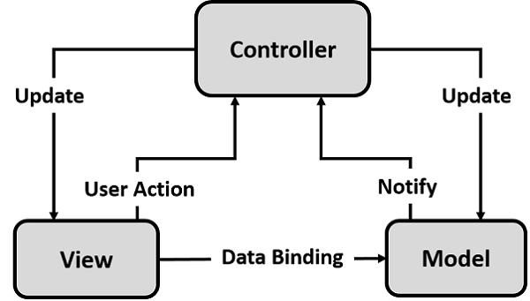
Concepts
2
MVC Concept
‹#›
© Copyright 2021, ZaranTech LLC. All rights reserved.

Slide 6
Concepts
2
Model - Features
Model acts as a bridge between the view and the application data.
Model is used to get the request from the view and respond as per the user’s input.
Model doesn’t depend on classes.
‹#›
© Copyright 2021, ZaranTech LLC. All rights reserved.

Slide 7
Concepts
2
View - Features
View is responsible to manage information display to the users.
Views are based on Model.
‹#›
© Copyright 2021, ZaranTech LLC. All rights reserved.

Slide 8
Concepts
2
Controller - Features
Controller is responsible for taking the input given by devices and communicates to model/view and to trigger correct action.
Controllers are based on model.
SAP UI5 offers Views and Controllers in the form of single files −
sap.ui.core.mvc.XMLView
sap.ui.core.mvc.JSView
sap.ui.core.mvc.Controller
sap.ui.core.mvc.JSONView
‹#›
© Copyright 2021, ZaranTech LLC. All rights reserved.

Slide 9
Concepts
2
JSON Model
JSON model is a client-side model and is used for small data sets.
JSON model supports two-way binding.
JSON model can be used to bind controls to JavaScript object data.
XML Model
XML model can be used to bind controls to XML data.
XML is also a client side model and hence is used only for small data sets.
XML model doesn’t provide any mechanism for server-based paging or loading of deltas.
XML model also supports two-way data binding.
‹#›
© Copyright 2021, ZaranTech LLC. All rights reserved.

Slide 10
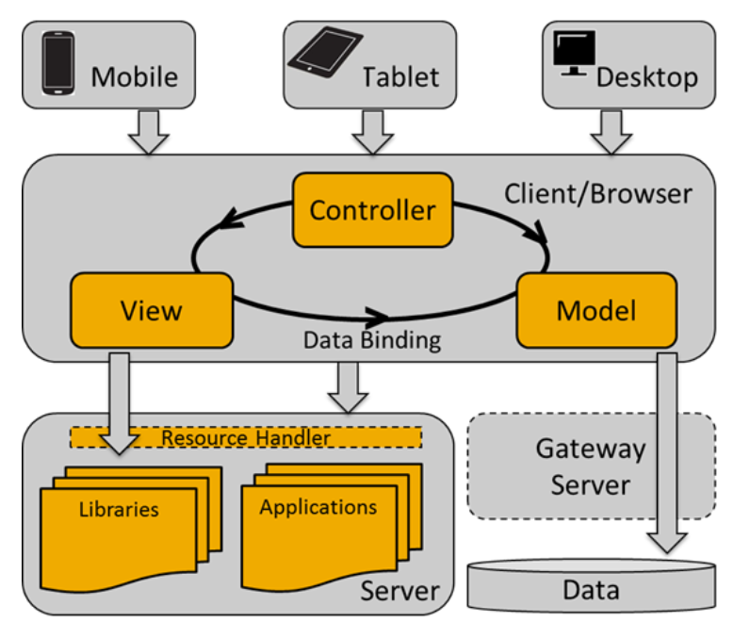
Concepts
2
SAP UI Development Toolkit for HTML5
‹#›
© Copyright 2021, ZaranTech LLC. All rights reserved.

Slide 11
Concepts
2
Resource Handling
The handling of resources in SAPUI5 is divided in a client-side and a server-side part.
The server-side mechanism is an optional component to improve the client-server interaction.
The server-side resource handling is mainly used in Eclipse to support the modularized development of SAPUI5 applications and libraries.
‹#›
© Copyright 2021, ZaranTech LLC. All rights reserved.

Slide 12
Concepts
2
SAP UI5 Control Libraries
There are various JavaScript and CSS libraries that you can use in combination for the application development.
SAPUI5 can use these libraries in combination and they are called SAPUI5 control libraries.
Common SAPUI5 control libraries:
Sap.ui.commons for control fields, buttons, etc.
Sap.m is the most common control library and is used for mobile devices
‹#›
© Copyright 2021, ZaranTech LLC. All rights reserved.

Slide 13
Concepts
2
SAP UI5 Control Libraries & Description
sap.m | Library with controls specialized for mobile devices.
sap.makit | SAPUI5 library contains the markit charts.
sap.ui.commons | Common library for standard controls
sap.ui.ux3 | SAPUI5 library with controls that implement the SAP User Experience(UX) Guidelines 3.0
sap.viz | SAPUI5 library containing chart controls based on the VIZ charting library.
‹#›
© Copyright 2021, ZaranTech LLC. All rights reserved.

Slide 14
Concepts
2
SAP UI5 Components
Components are independent and reusable parts used in SAPUI5 applications.
An application can use components from different locations from where the application is running.
Components also support the encapsulation of closely related parts of an application into a particular component.
This makes the structure of an application and its code easier to understand and to maintain.
‹#›
© Copyright 2021, ZaranTech LLC. All rights reserved.

Slide 15
Concepts
2
SAP UI5 Components
SAP UI5 Components
Faceless Components
UI Components
‹#›
© Copyright 2021, ZaranTech LLC. All rights reserved.

Slide 16
Concepts
2
SAP UI5 Components
A component is a folder.
The folder name defines the component name and contains all optional and required resources.
These are used in the component except for the required SAPUI5 libraries and child components.
Component Structure
Component.js
Compoennt.json
‹#›
© Copyright 2021, ZaranTech LLC. All rights reserved.

Slide 17
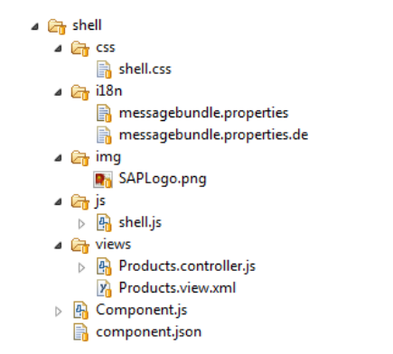
Concepts
2
SAP UI5 Components – Example Component Structure
‹#›
© Copyright 2021, ZaranTech LLC. All rights reserved.

Slide 18
Concepts
2
Differentiation to Other Concepts in SAP UI5
Composite Controls
UI Library
Notepad Control
MVC
Application
‹#›
© Copyright 2021, ZaranTech LLC. All rights reserved.

Slide 19
Concepts
2
Fragments
Fragments are pieces of UI, just like SAPUI5 MVC views, but without the view control around the content and without their own controller.
Fragment Types
XML Fragments
HTML Fragments
JS Fragments
‹#›
© Copyright 2021, ZaranTech LLC. All rights reserved.

Slide 20
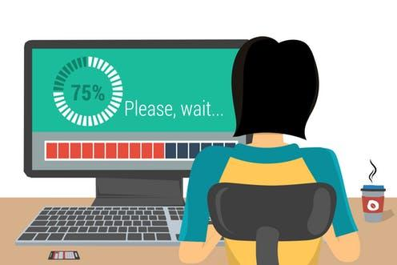
Concepts
2
Lets see, What is XML Fragments?
‹#›
© Copyright 2021, ZaranTech LLC. All rights reserved.

Slide 21
Concepts
2
Lets see, What is HTML Fragments?
‹#›
© Copyright 2021, ZaranTech LLC. All rights reserved.

Slide 22
Concepts
2
Lets see, What is JS Fragments?
‹#›
© Copyright 2021, ZaranTech LLC. All rights reserved.

Slide 23
Thank you
Subscribe to our Channel for more Informative Videos.
https://www.youtube.com/user/ZaranTech

